Slide 1
Inducible Genome Modification Utilizing Ty1 Retrotransposons
Brandon Dorr
Kylie Standage-Beier
Dr. Xiao Wang
4/22/2017

Slide 2
What is Synthetic Biology?
Design and engineer of biology for useful purposes
  Biofuels
  Therapeutics
  Waste Management
  Compound Production
Cellular Factories
syntheticbiology.org

Slide 3
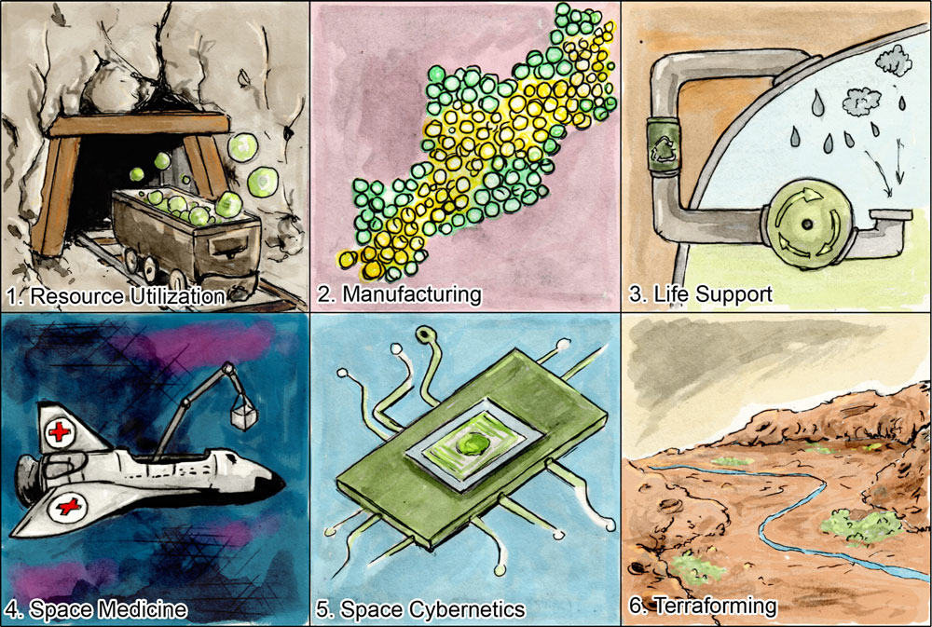
Need for Inducible, Efficient Genome Modification (Space and Industrial)
Biological hardware replicates itself
Flexible and Scalable
Programable Biosensors
Engineering is accomplished at the DNA level
(Menezes et al., 2015)

Slide 4
Inducible Genome Modification System:
Application for Space Exploration
+
Plasmid System
(Circular DNA)
Yeast
Notes:
First I am going to quickly outline the desired end product and function of this system and its industrial application. We plan to make a plasmid system that

Slide 5
Inducible Genome Modification System:
Application for Space Exploration
+
=
Plasmid System
(Circular DNA)
Yeast
Yeast + Plasmid

Slide 6
Inducible Genome Modification System:
Application for Space Exploration
Stimulus
Yeast + Plasmid
Selective Pressure
Applied

Slide 7
Inducible Genome Modification System:
Application for Space Exploration
Stimulus
Genome
Integration
Yeast + Plasmid +
Integration of Gene of Interest
Yeast + Plasmid
Selective Pressure
Applied

Slide 8
Inducible Genome Modification System:
Application for Space Exploration
Stable Expression
From Genome
Notes:
Plasmids often pose a Cellular Burden
Integration of your desired gene of interest into the genome can allow for more efficient expression without the need of continued selective pressure and without the burden associated with plasmid replication

Slide 9
Control Genome Modification through
Intracellular Editing Template Production

Slide 10
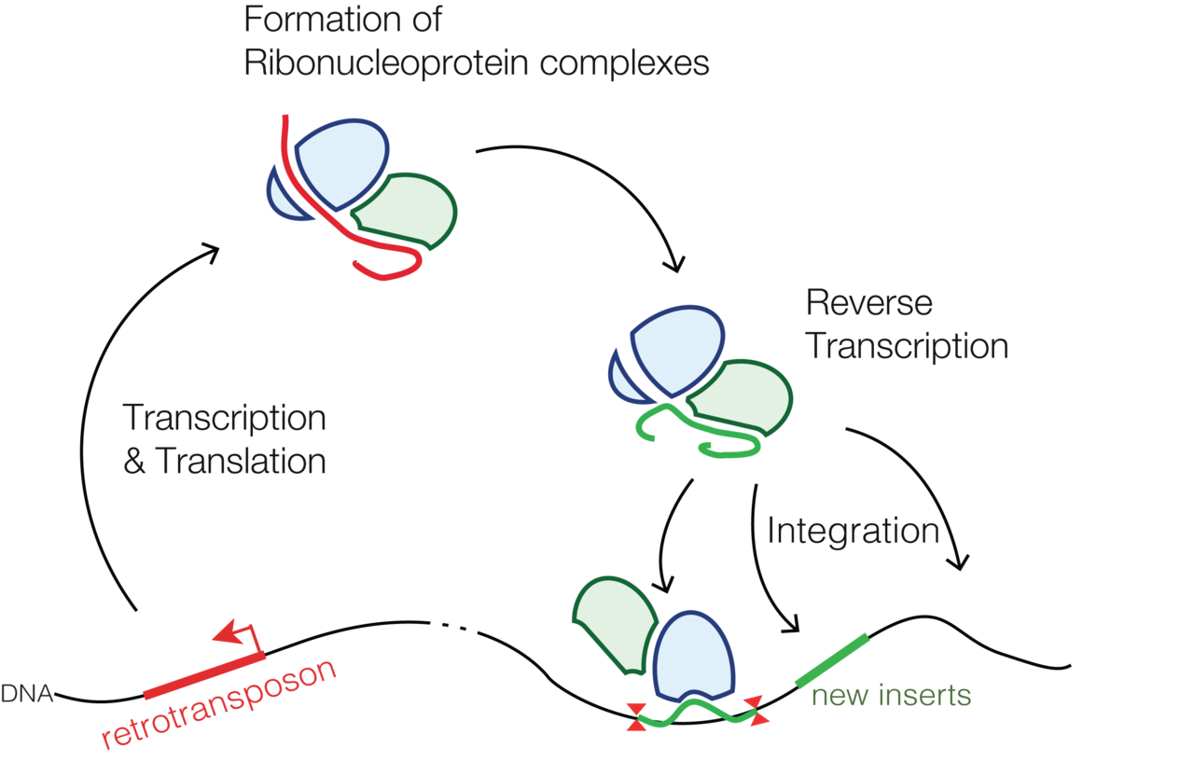
Transposons and Retrotransposons
Genetic elements naturally occurring in prokaryotes and eukaryotes
Make up a large portion of overall genetic material
‘Jumping Genes’
By Mariuswalter - Own work, CC BY-SA 4.0, https://commons.wikimedia.org/w/index.php?curid=41382898
Notes:
Role in mutation and evolution
One study estimated the rate of transposition of a particular retrotransposon, the Ty1 element in Saccharomyces cerevisiae. Using several assumptions, the rate of successful transposition event per single Ty1 element came out to be about once every few months to once every few years.^{[33]} Some TEs contain heat-shock like promoters and their rate of transposition increases if the cell is subjected to stress,^{[34]} thus increasing the mutation rate under these conditions, which might be beneficial to the cell. –wiki
Plate photo from paper cited to show tangible stuff – show how its real

Slide 11
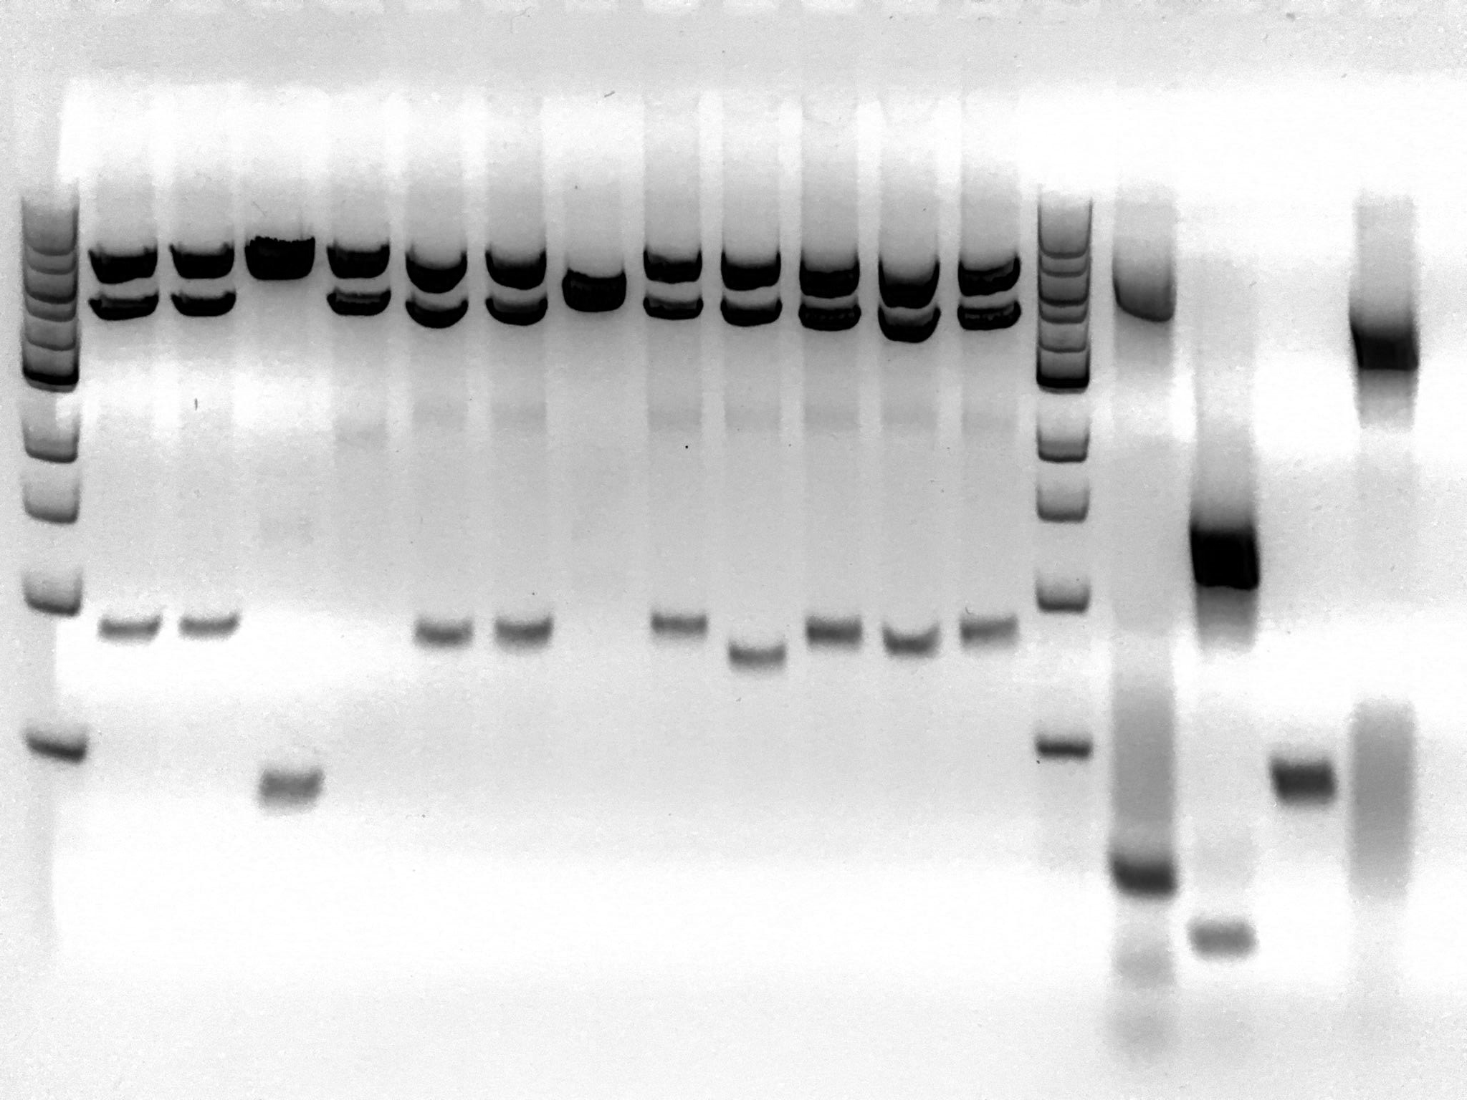
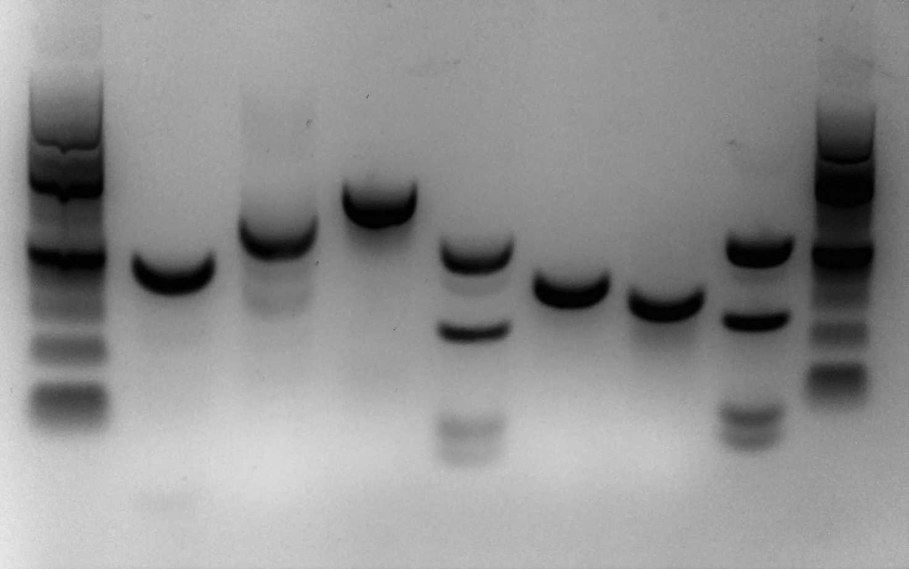
Ty1 Donor/Helper System Construction
Parts of Ty1 Donor System: (Left to Right) 100 bp Ladder, Gal Promoter ~340 bp, mini α ~580 bp, GFP ~710 bp, Intron ~123 bp, Tef1 Promoter ~400 bp, Mini β ~360 bp.
Parts of Ty1 Helper System: (Left to Right) 1kb bp Ladder, GagPol ~ 5270 bp, Gag ~1320 bp, Gal Promoter ~340 bp, Pol ~3980 bp.
Notes:
Figure 3. Parts of Ty1 Donor System: (Left to Right) 100 bp Ladder, Gal Promoter ~340 bp, mini α ~580 bp, GFP ~710 bp, Intron ~123 bp, Tef1 Promoter ~400 bp, Mini β ~360 bp.

Slide 12
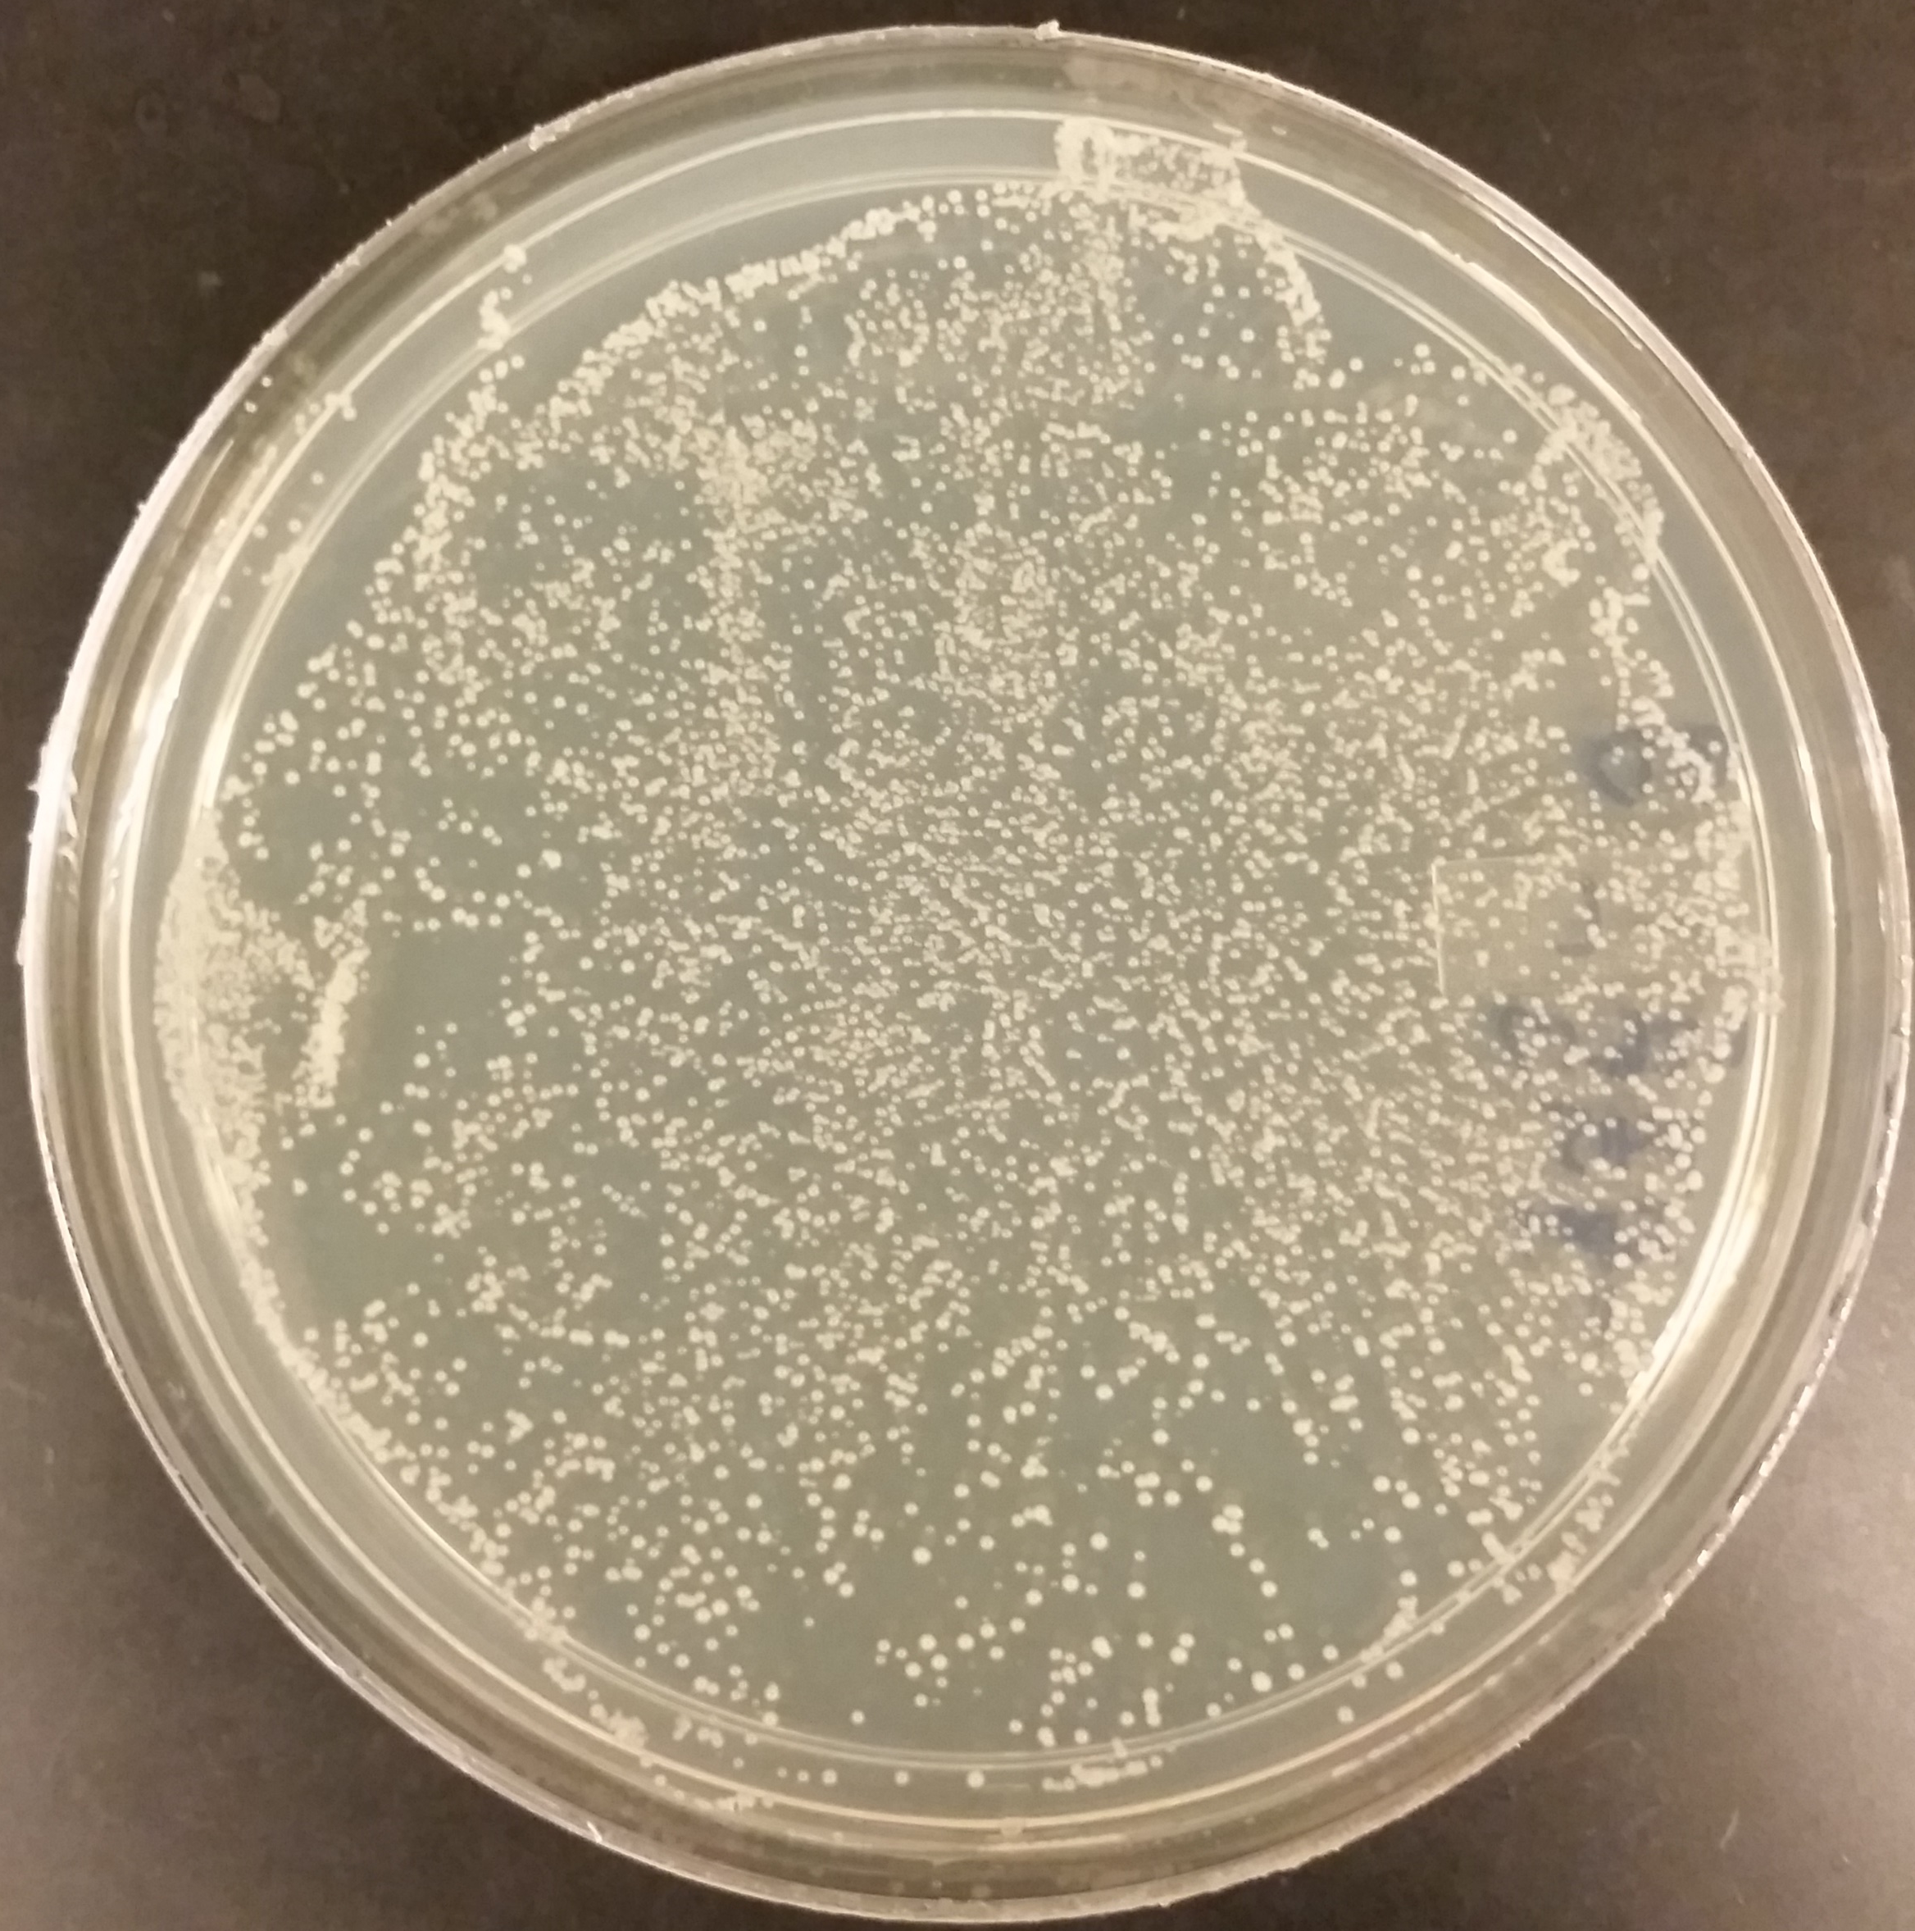
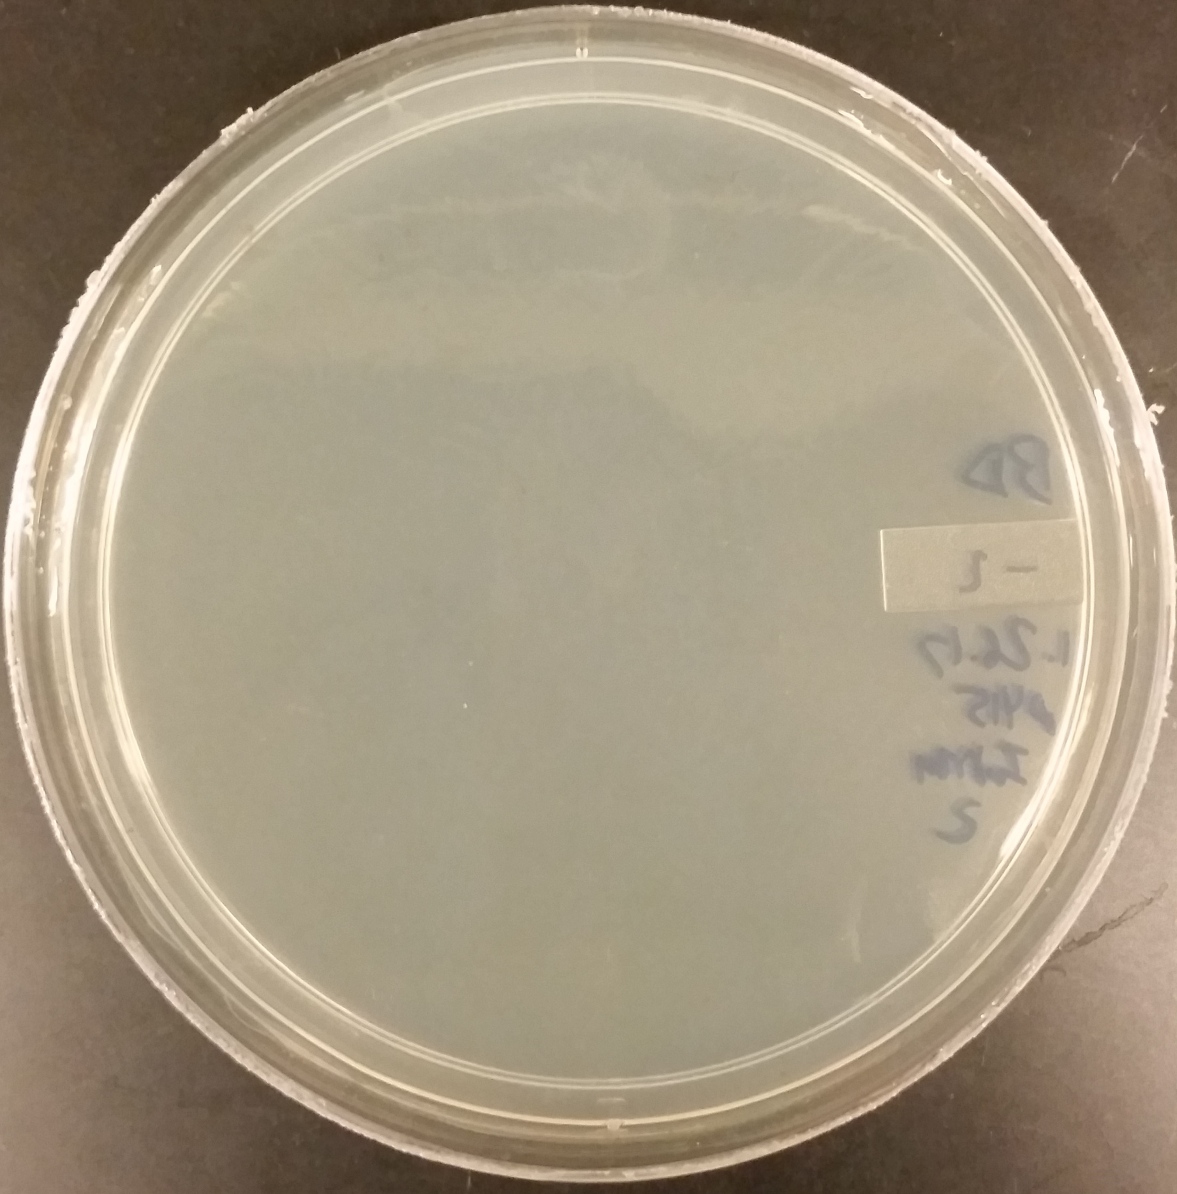
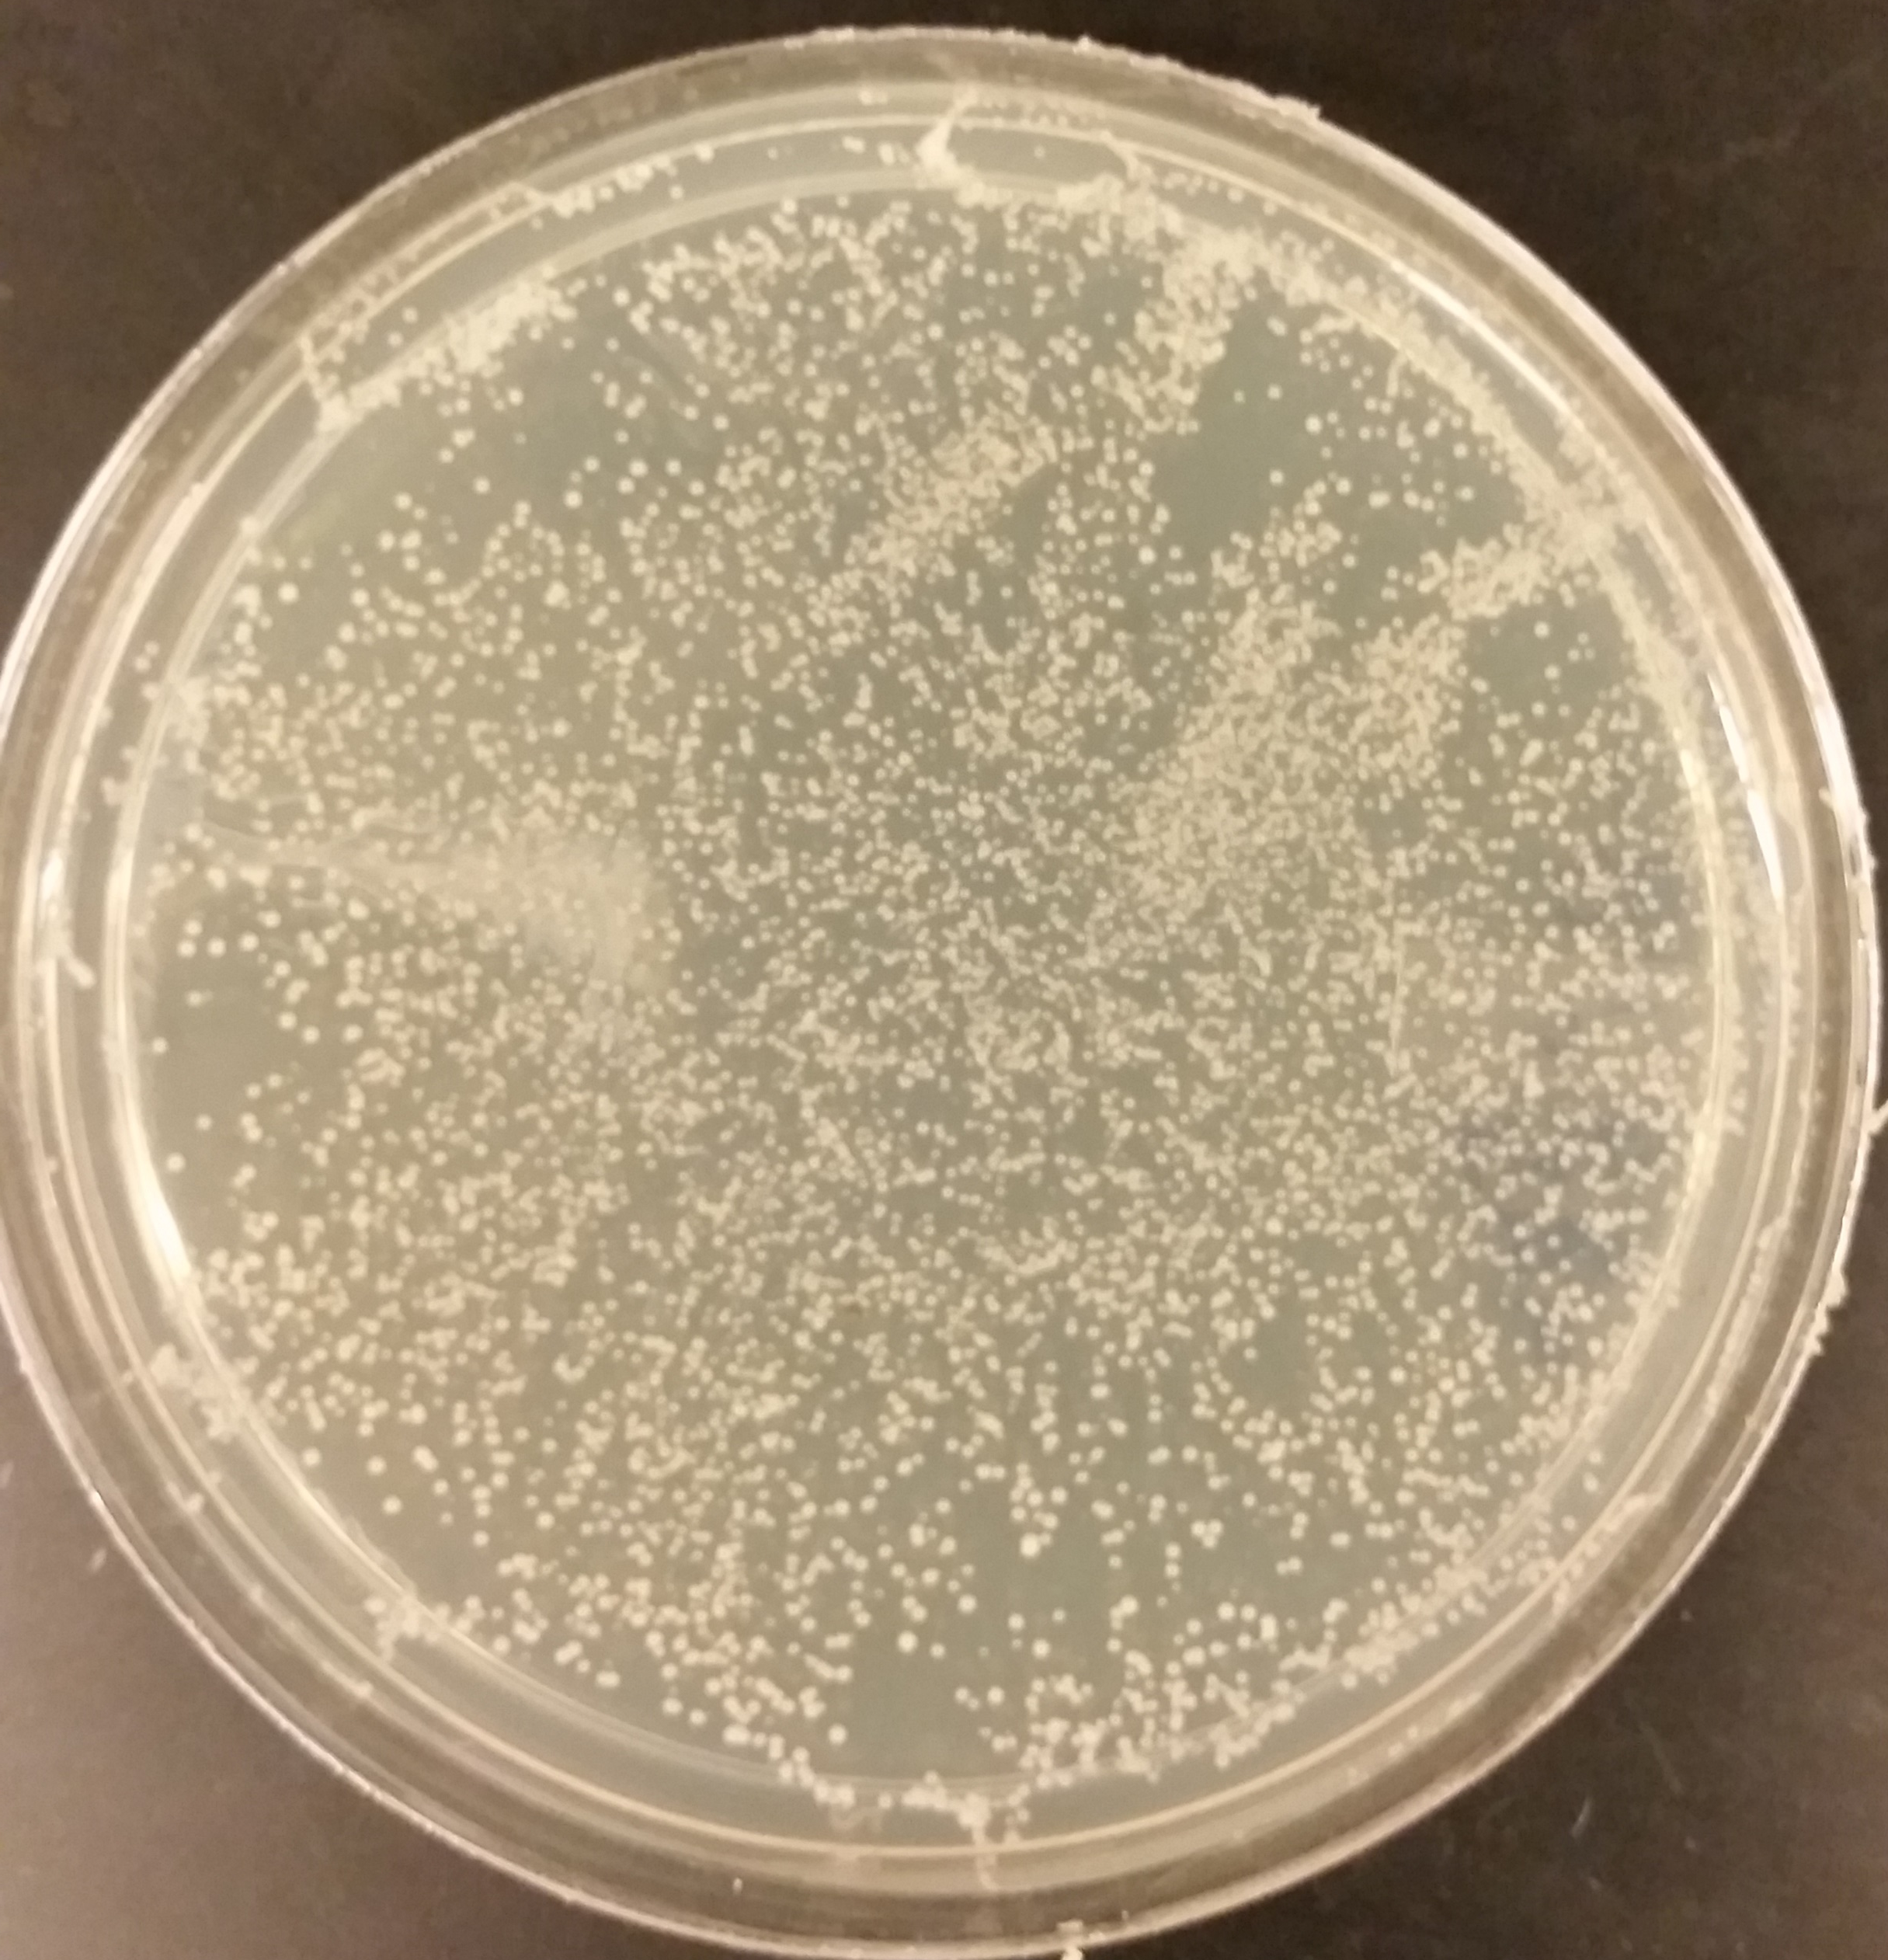
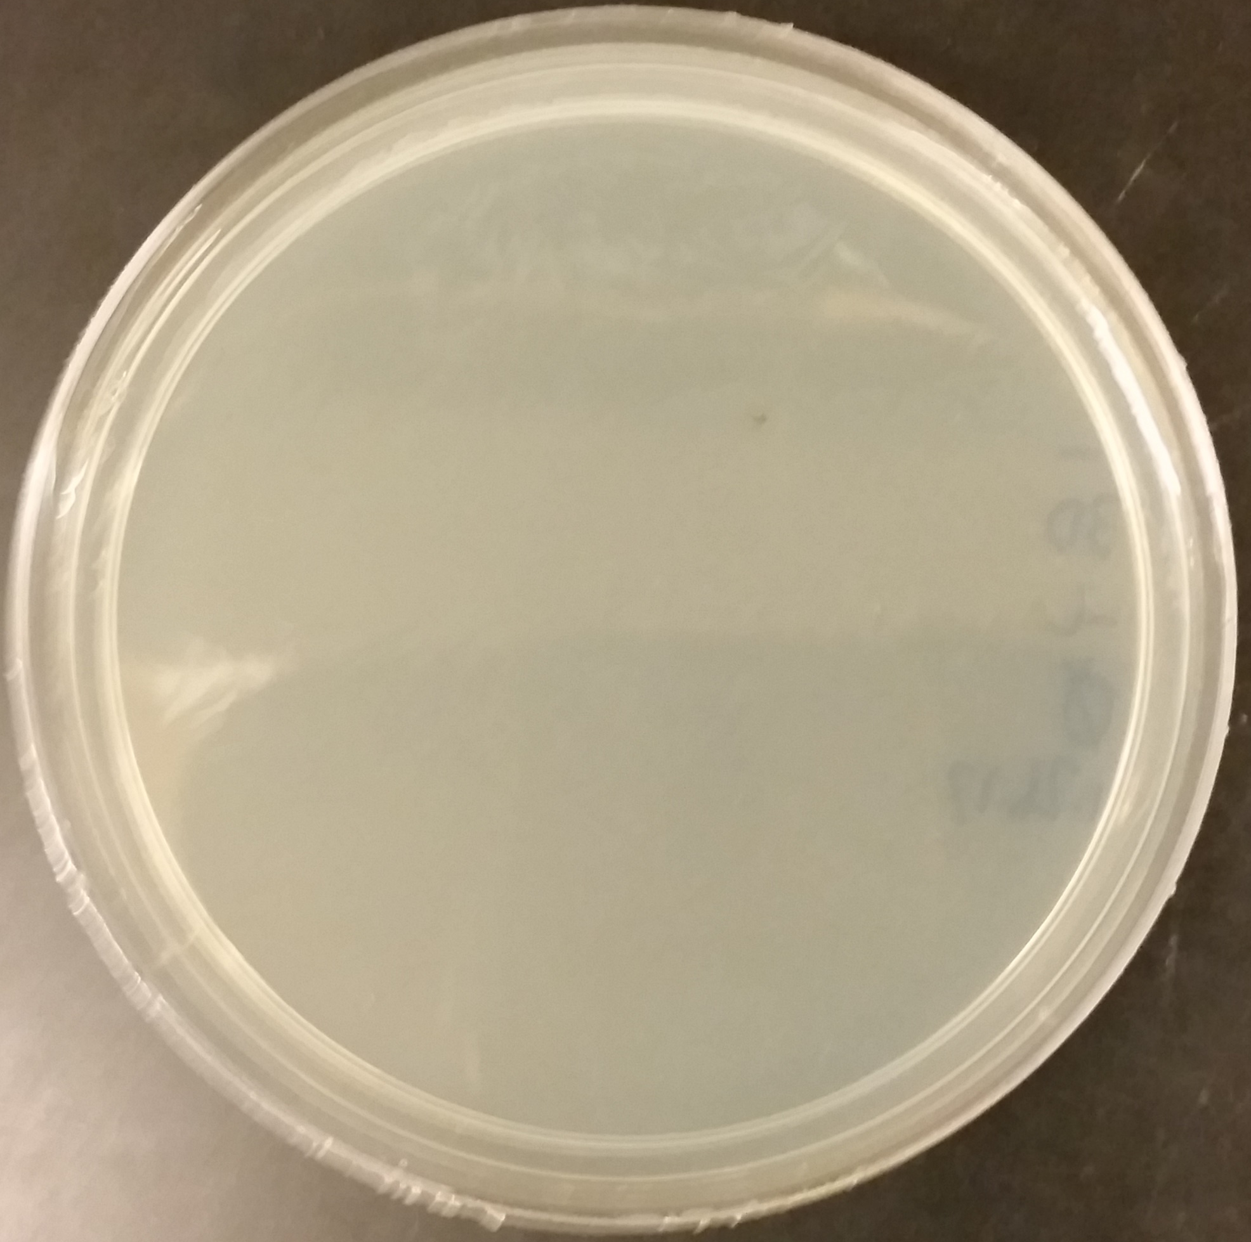
Artificial Intron
Splices from
Leu2
Intron 1 (Forward) (Leu2 Expression = Successful Splicing) | Intron 2 (Backward) (No Leu2 Expression = Unsuccessful Splicing)
Control +plasmid (Leu2 Expression) | Control -plasmid (No Leu2 Expression)
Le
Intron
u2
Promoter
Notes:
Imagine you sending this plasmid – need intron to control unwanted expression

Slide 13
Future Directions and Conclusions
Cell specific activation and genome integration
Integration of larger gene network payload
Optimization of integration efficiency
Additions allowing for location-specific targeted modification
(Menezes et al., 2015)

Slide 14
Acknowledgements
Dr. Xiao Wang
Kylie Standage-Beier
Wang Lab Members
Dr. Thomas Sharp and Ms. Desiree Crawl
ASU/NASA Space Grant

Slide 15
References
Menezes, A.A., Montague, M.G., Cumbers, J., Hogan, J.A., and Arkin, A.P. (2015). Grand challenges in space synthetic biology. J R Soc Interface 12.
Farzadfard, F., and Lu, T.K. (2014). Genomically encoded analog memory with precise in vivo DNA writing in living cell populations. Science 346, 1256272.
Curcio, M.J., Lutz, S., and Lesage, P. (2015). The Ty1 LTR-Retrotransposon of Budding Yeast, Saccharomyces cerevisiae. Microbiology Spectrum 3.
Bolton, E.C., Coombes, C., Eby, Y., Cardell, M., and Boeke, J.D. (2005). Identification and characterization of critical cis-acting sequences within the yeast Ty1 retrotransposon. RNA 11, 308–322.
Huang, Q., Purzycka, K.J., Lusvarghi, S., Li, D., LeGrice, S.F.J., and Boeke, J.D. (2013). Retrotransposon Ty1 RNA contains a 5′-terminal long-range pseudoknot required for efficient reverse transcription. RNA 19, 320–332.

Slide 16
Medical Application Goal
+
=
Plasmid System
Patient’s
Cells
Cells + Plasmid

Slide 17
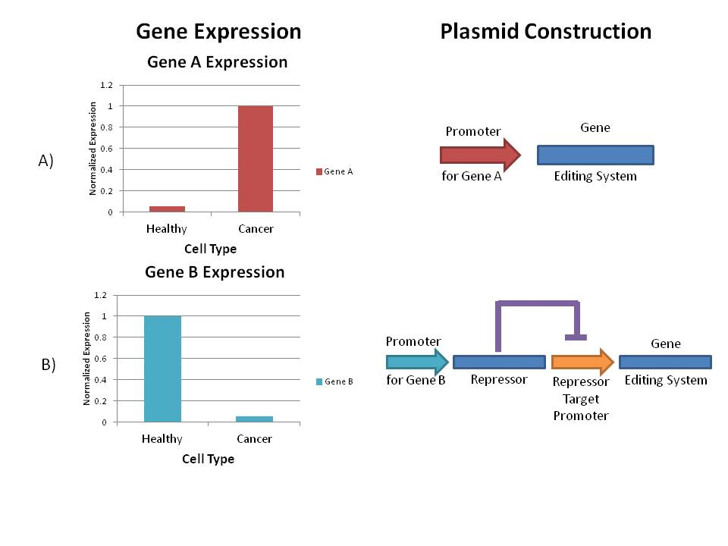
Medical Application Goal
Cell Specific
Genome
Integration
Gene Therapy to
Targeted Cells
Cells + Plasmid

Slide 18
Need for Inducible, Efficient Genome Modification (Medical)
Cell-subtype specific genome modification
  Limits quantity of editing
  Limit off-target effects
Activate in cancerous cell lines to deliver gene payload
Restore expression of damaged genes
Notes:
As this system is entirely controlled within the cell with typical gene expression, its plausible that this circuit could be designed to only express in a target cell line, for instance a cancerous cell line. When the treatment (the gene circuit) is implemented to a wide area of cells, theoretically it could activate only in cells with a specific gene expression profile. With many activator and inhibitor systems, even with a inherently analog biological system, editing could occur only in a desired cell subtype. As a theraputic, this could limit side effects, as the intensite of the treatment is ideally reduced.
Figure 1. Simple demonstration of logic gates used to activate the gene editing systems in the desired cell type. A) Unique Expression in Target Cell Line. B) Unique Cell Expression in Non-Target Cell Line

Slide 19
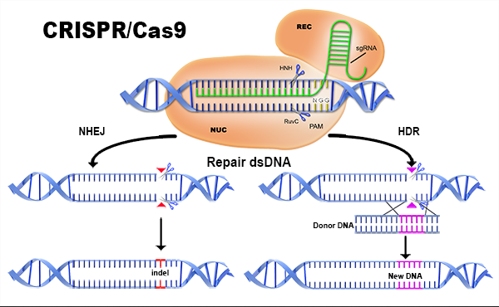
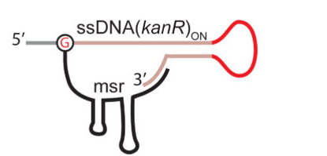
SCRIBE
Cell
SCRIBE
+
SCRIBE ssDNA
(Farzadfard and Lu, 2014)

Slide 20
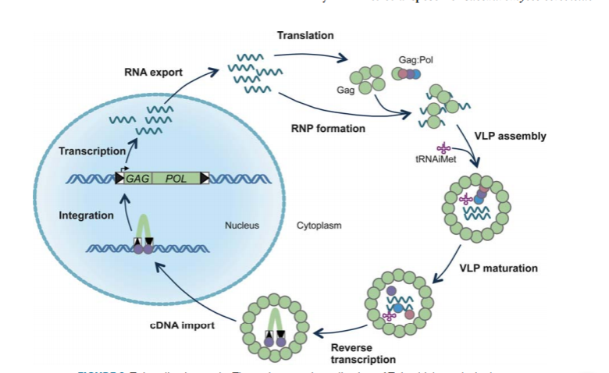
Ty1 Retrotransposon
(Curcio et al., 2015)

Slide 21
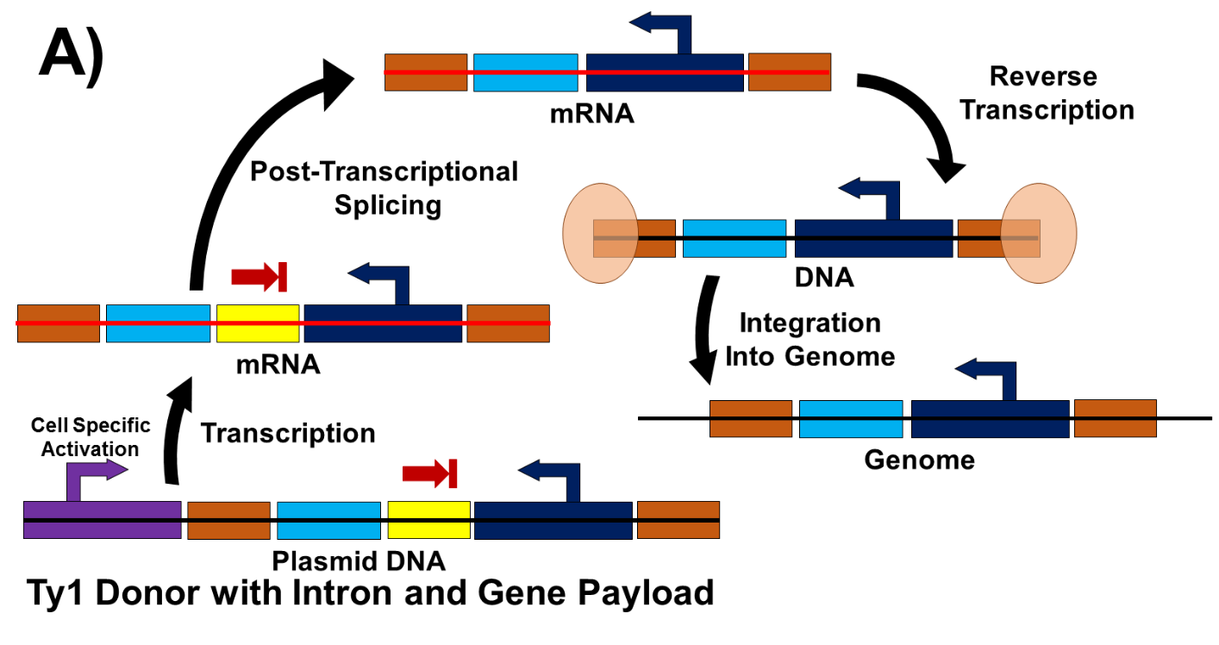
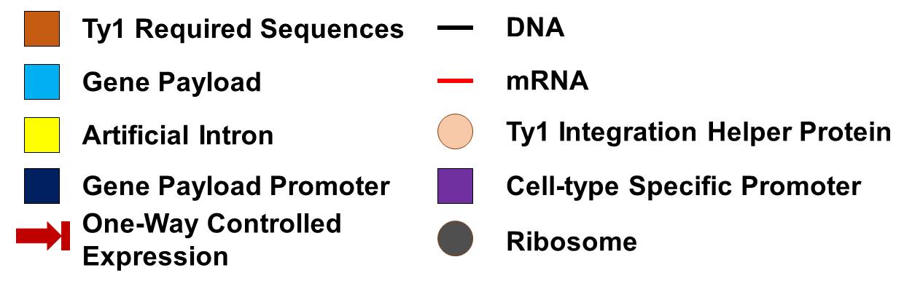
Designed Donor Plasmid Activity
Ty1 Donor contains an artificial intron
Intron splices prior to reverse transcription and genome integration
Proper expression of gene payload occurs from genome
Intron is designed to limit expression of gene payload from delivery Ty1 Donor plasmid
Notes:
Figure 2. Artificial Intron Function. A) Splicing occurs prior to integration of gene payload into genome. B) Artificial intron blocks unwanted expression of gene payload.

Slide 22
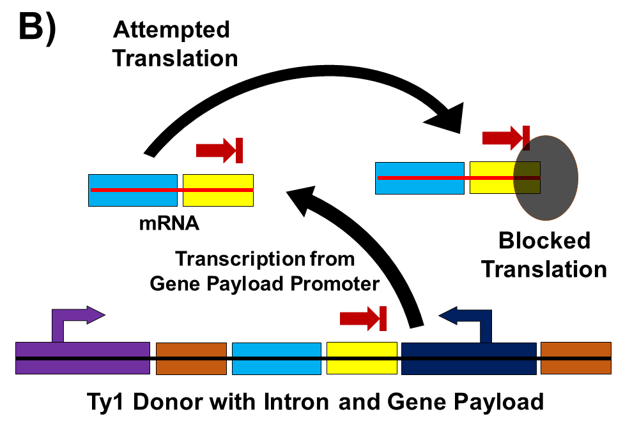
Designed Donor Plasmid Activity
Artificial intron blocks unwanted expression of gene payload
Directional splicing does not allow for splicing to occur when transcription begins from the payload promoter
Notes:
Figure 2. Artificial Intron Function. A) Splicing occurs prior to integration of gene payload into genome. B) Artificial intron blocks unwanted expression of gene payload.

Slide 23
Designed Helper Plasmid
Helper 1 (Two ORF transcribed from one GAL promoter)
Helper 2 (Two ORF separated and transcribed from two GAL promoters)
GAL
GAG
POL
GAL
GAL
GAG
POL

Slide 24
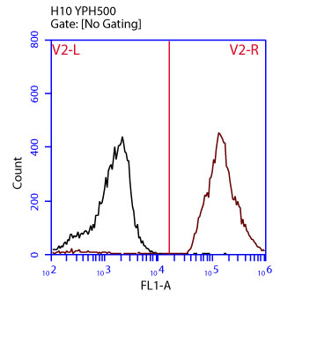
Expected Non-Induced Control Activity
Non-Induced (Glucose)
No Induction of Ty1 System
No GFP Integration
No GFP Expression
GFP
-
+

Slide 25
Expected Induced Activity
Non-Induced (Glucose)
Induced (Galactose) (~72 hr)
Induction of Ty1 System
GFP Integration
GFP Expression
GFP
-
+
-
+

Slide 26
Expected Continued Induction Activity
Non-Induced (Glucose)
Induced (Galactose) (~96 hr)
Continued Induction of Ty1 System
Multiple Copy GFP Integration
Multiple Copy GFP Expression
GFP
-
+
-
+
2+

Slide 27
Expected Continued Induction Activity
Non-Induced (Glucose)
Induced (Galactose) (After Dilutions)
Continued Induction of Ty1 System
Multiple Copy GFP Integration
Multiple Copy GFP Expression
GFP
-
+
-
+
2+
3+

